Slide 1
Image Exif Data Analyzer / Categorizer Find the cute baby
Sheraz A Choudhary
Python for Data Science, CSCI E-29
Harvard University

Slide 2

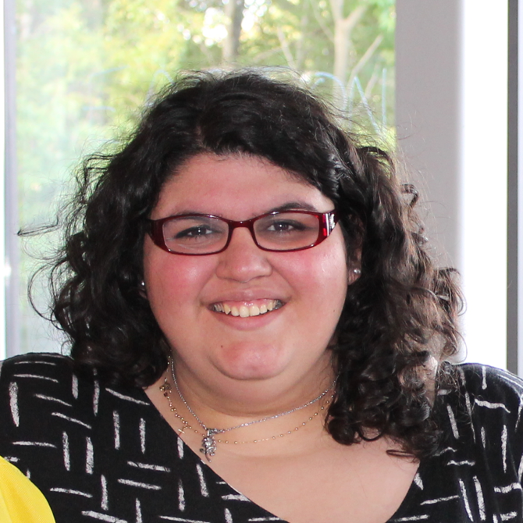

CSCI E-29 2018 Staff
Nenad Svrzikapa
Instructor
Lena Hajjar
Teaching Fellow
Philip Lodine
Teaching Fellow
Kaleigh Douglas
Teaching Fellow
Alan Xie
Teaching Fellow
Joe Palin
Teaching Fellow

Slide 3
Abstract
Max = 10
Digital images have hidden information containing the all camera settings used to capture the image (the EXIF).
Given a directory, this project aims to scan the directory and read this EXIF data for every image found. Using pandas, I will manipulate this data to extract relevant features.
My images contain some subject information in the file names and I will use this label information to train a model using the features generated from the EXIF data. Let’s see if we can find a cute baby!

Slide 4
Required Libraries and files
os, sys (read and write to filesystem)
pandas
numpy
PIL (read EXIF data)
math
sklearn
matplotlib
seaborn
plotly / cufflinks
pydotplus
https://github.com/sherazch00/e29-exif-reader/

Slide 5
REFERENCES
This project would not have been possible without the numerous sample code from CSCI E-29 Lectures, Sections & Problem Sets.
The internet has also been a great friend especially Stackoverflow. Citations are included in the notebook as needed.
Thank you CSCI E-29 staff and the developer community.

Slide 6
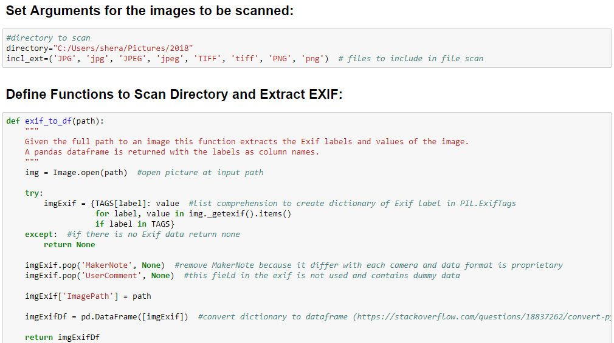
Project Notebook

Slide 7
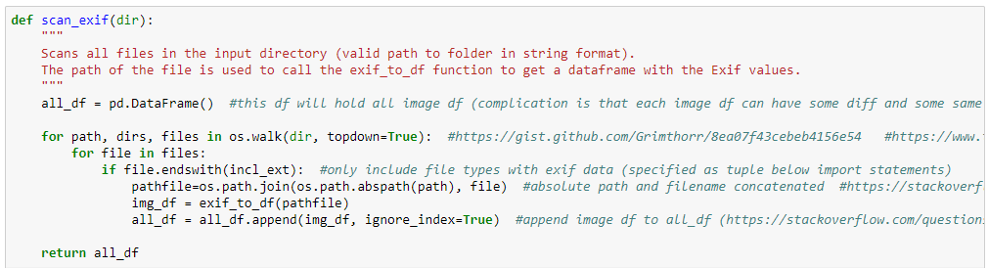
Project Notebook

Slide 8
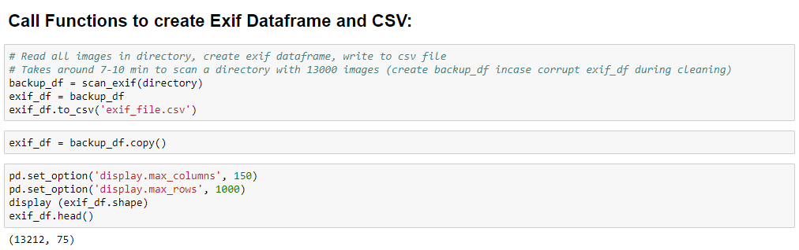
Project Notebook

Slide 9
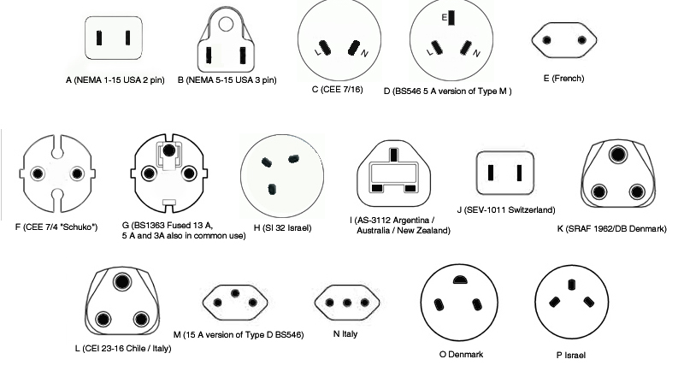
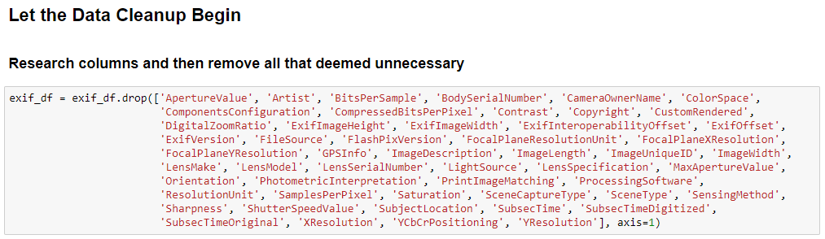
Project Notebook

Slide 10
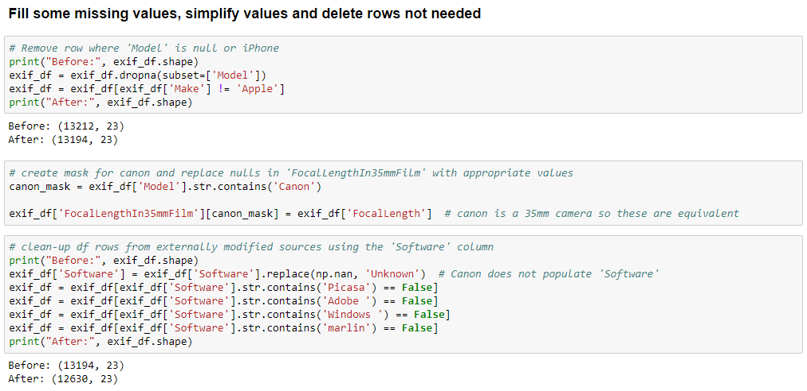
Project Notebook

Slide 11
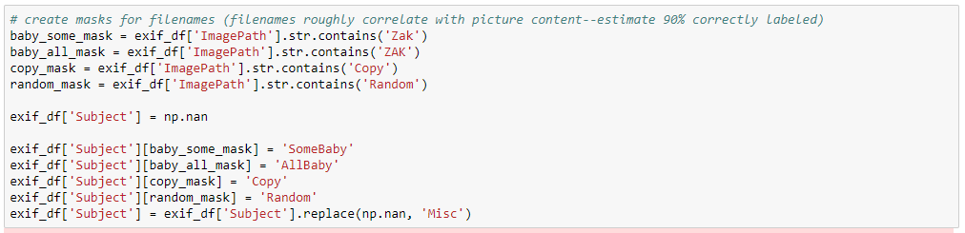
Project Notebook

Slide 12
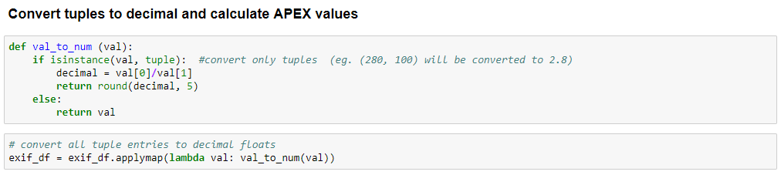
Project Notebook

Slide 13
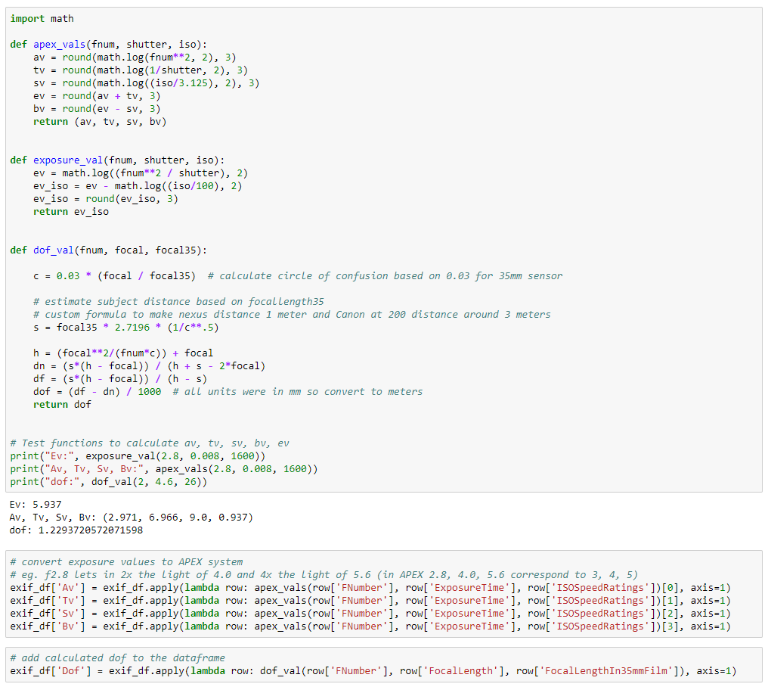
Project Notebook

Slide 14
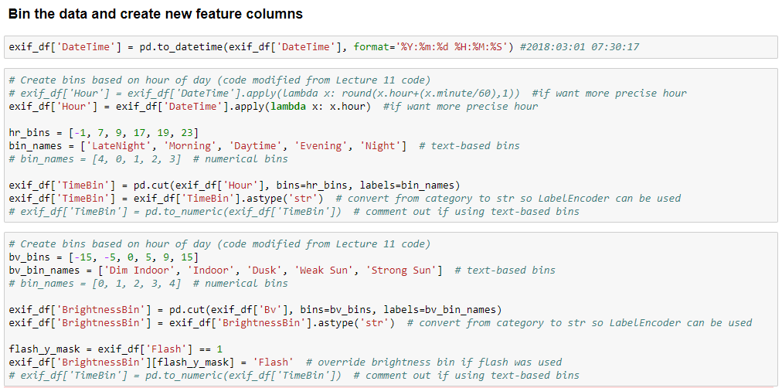
Project Notebook

Slide 15
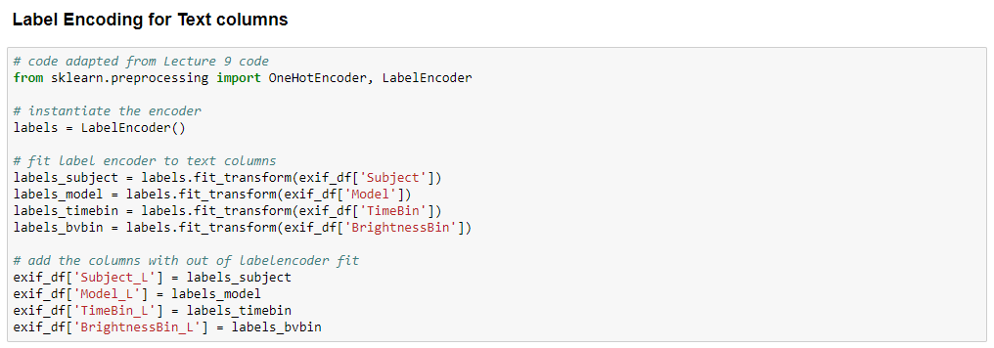
Project Notebook

Slide 16
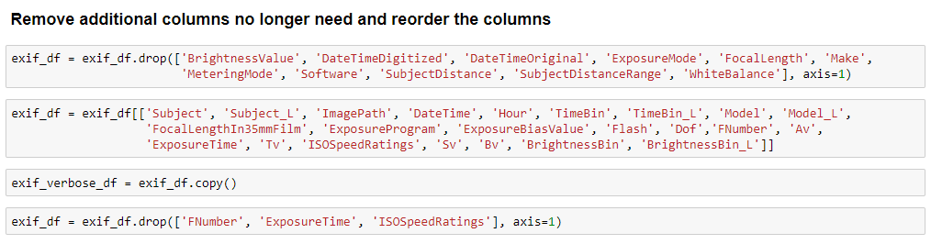
Project Notebook

Slide 17
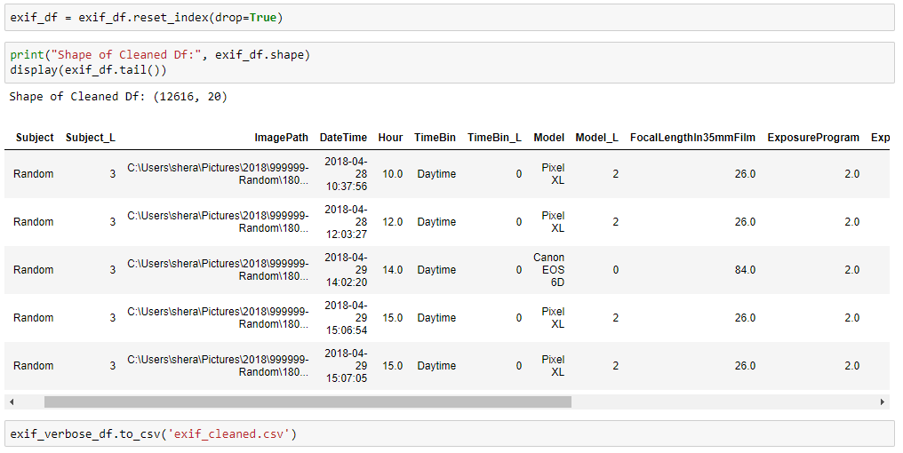
Project Notebook

Slide 18
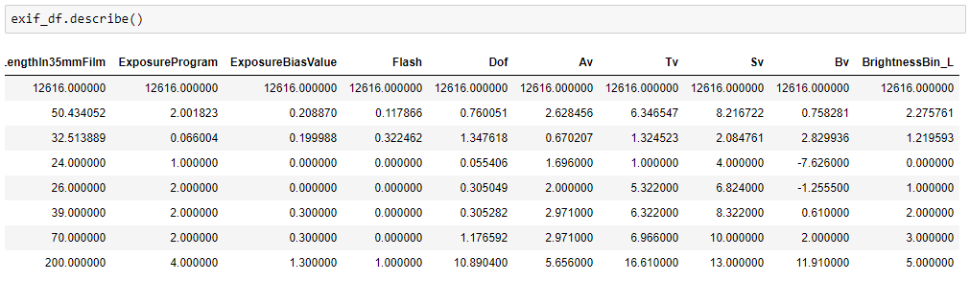
Project Notebook

Slide 19
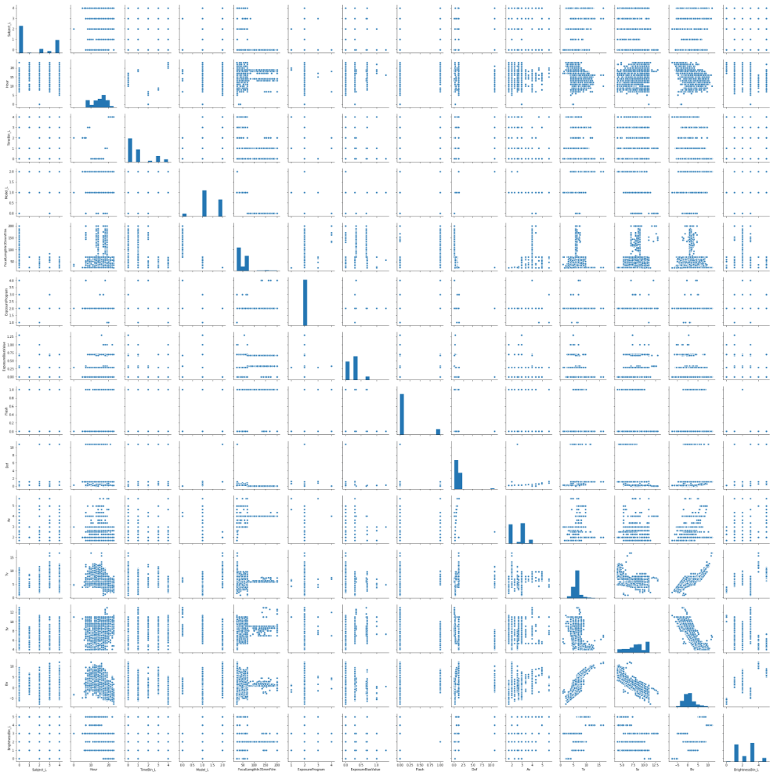
Project Notebook

Slide 20
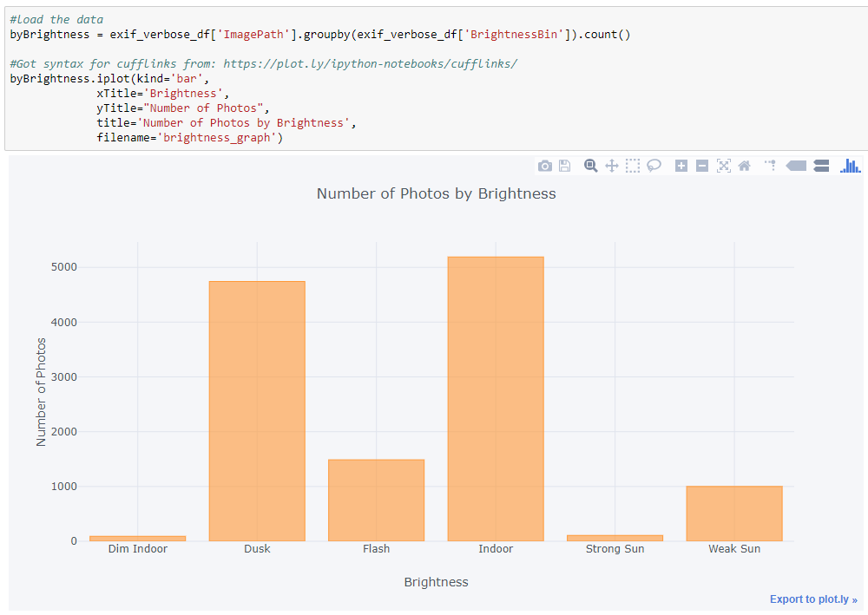
Project Notebook

Slide 21
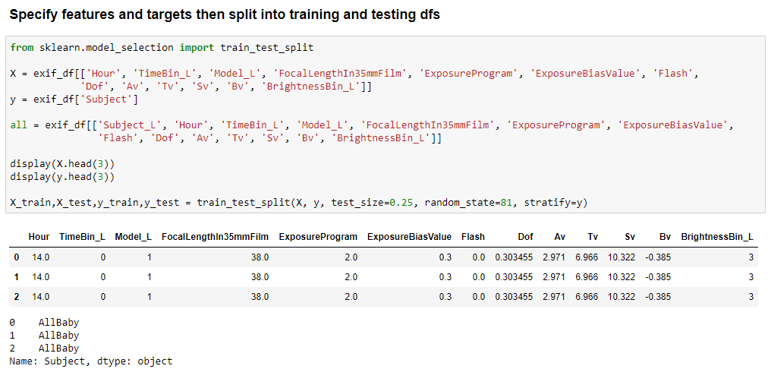
Project Notebook

Slide 22
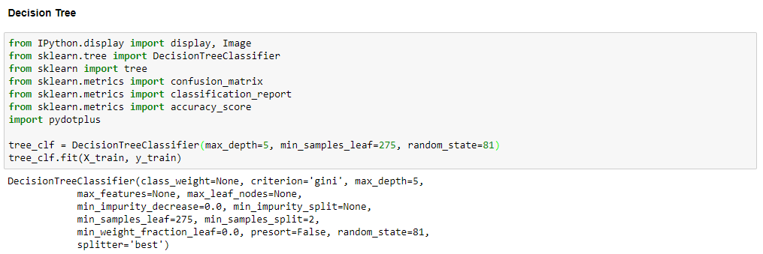
Project Notebook

Slide 23
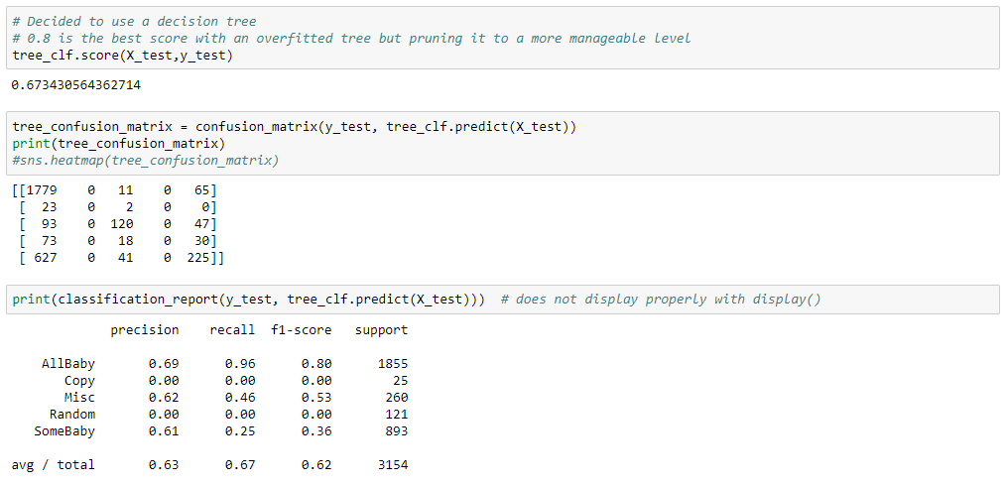
Project Notebook

Slide 24
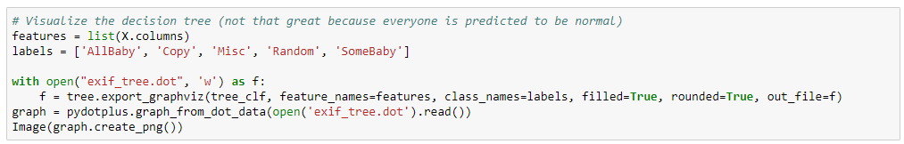
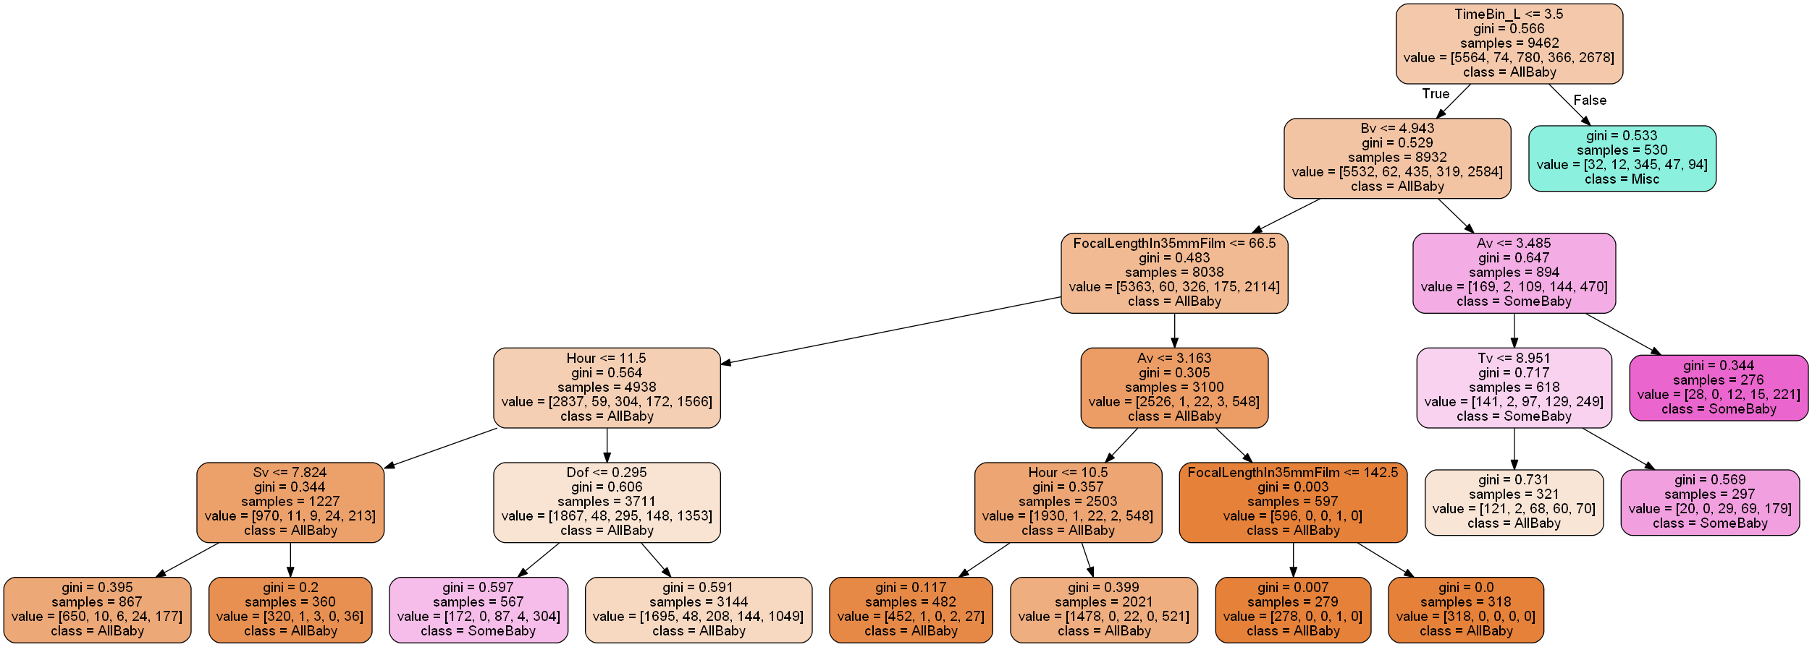
Project Notebook

Slide 25
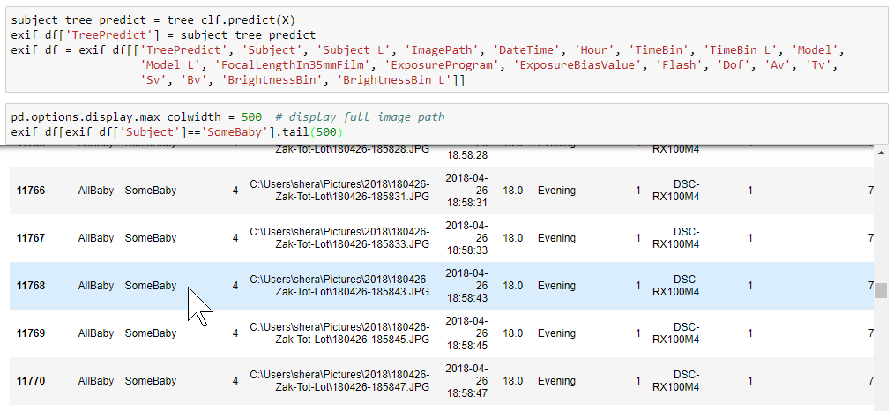
Project Notebook

Slide 26
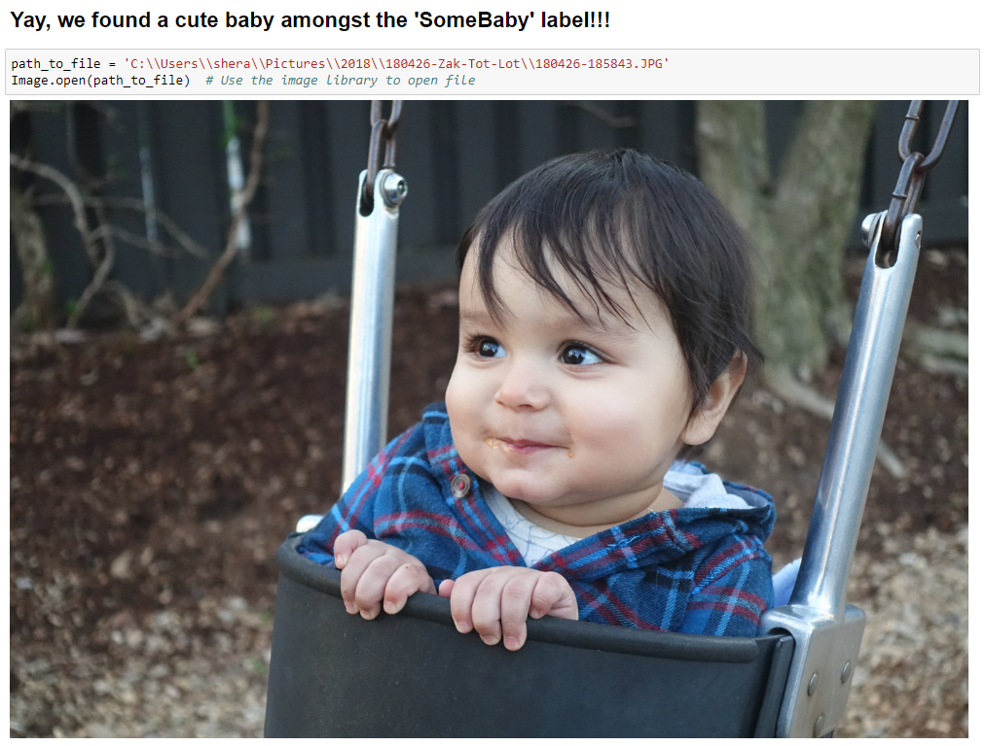
Project Notebook

Slide 27
OTHER MODELS TRIED
Perceptron (Accuracy of 0.63)
Naive Bayes Classification (Accuracy of 0.33)
Kmeans (Confirms that there are 3 clusters)

Slide 28
FINAL THOUGHTS
THANK YOU TO THE STAFF AND STUDENTS OF CSCI E-29 (SPRING 2018)

